Slide 1
Brick Breaker
Presented by -
Nimisha Doshi(13)

Slide 2
Overview
I have come up with a brick-breaker game, something in vein of the popular blackberry brick-breaker game.
A set of bricks will be arranged above the bar with the help of which player will be able to swerve the ball in order to hit bricks. Once all the bricks are destroyed by the ball, player wins the game.
The game is easy and fun to play. It can be enjoyed by anybody, be it a small kid or an old man. The learning curve is almost negligible and the game is not time consuming.

Slide 3
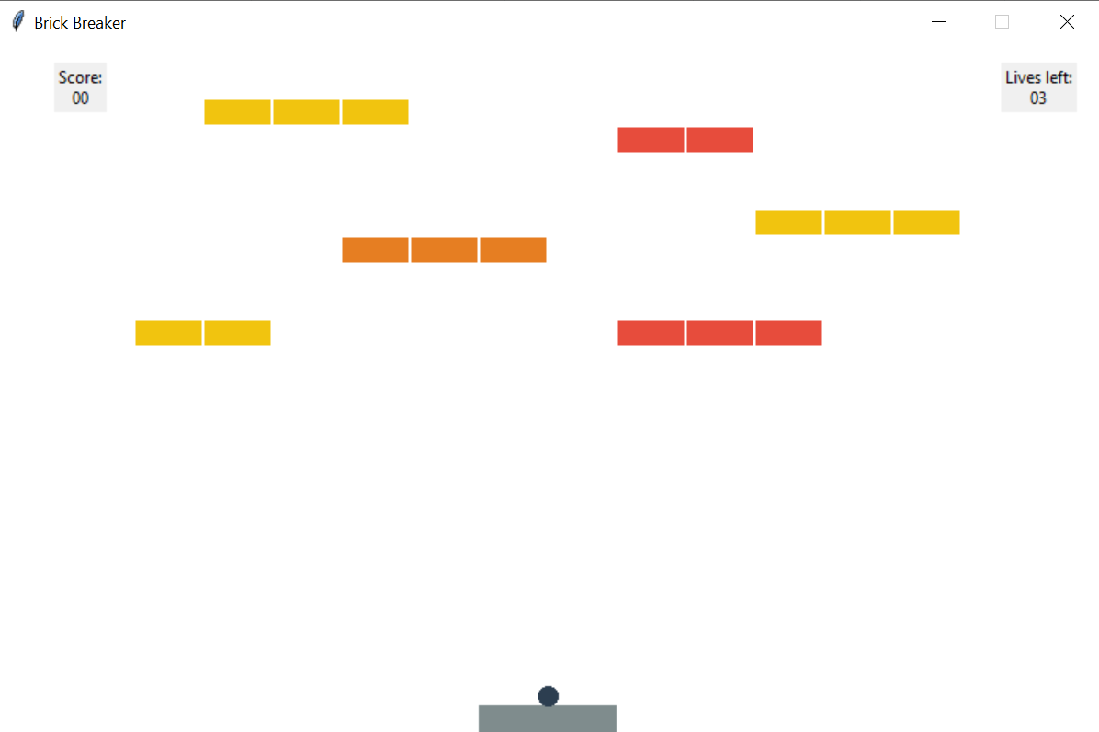
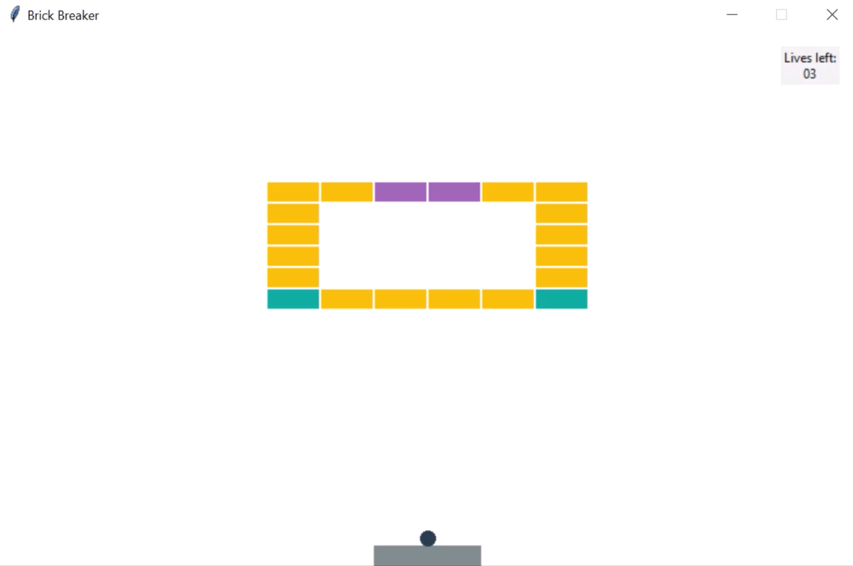
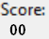
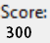
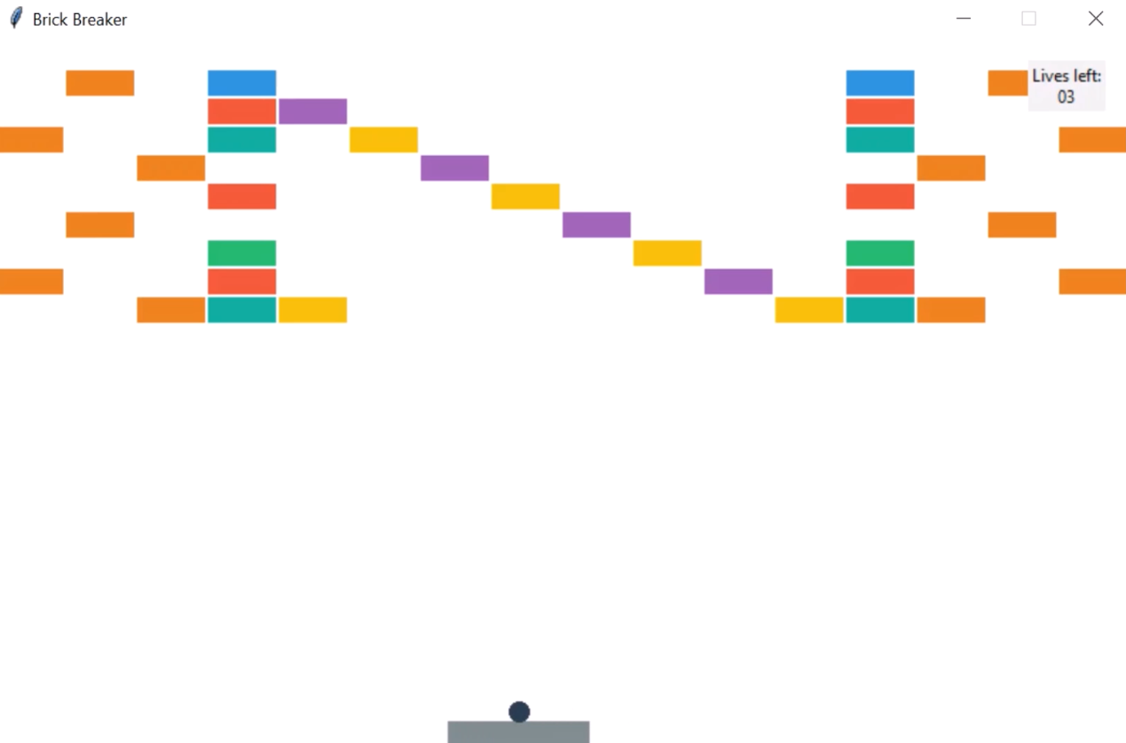
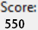
Design Work
3 Levels are as follows
Level -1
Level - 2
Level - 3

Slide 4
Design Work : Level 1

Slide 5
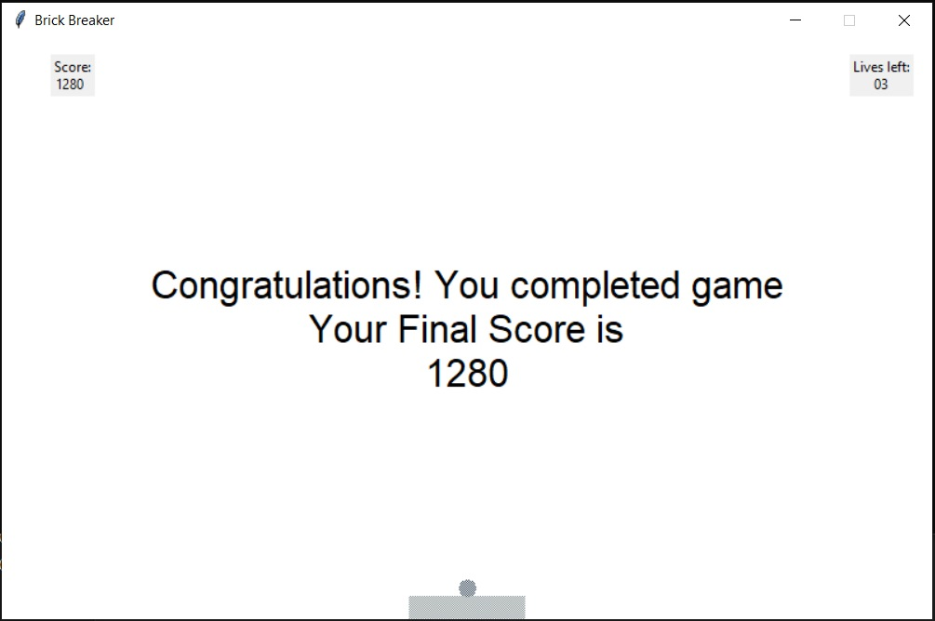
Design Work : Game Completion

Slide 6

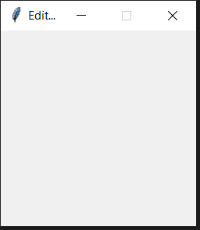
Language and Technology used
I have used Python 3.9 as our language to create our game.
I have used Tkinter to create GUI of the game.

Slide 7
Features
A scoring system that corresponds when Brick gets hit by the Ball.
A very flexible level system.
With multiple lives.
Vibrant Brick Colours producing various effects like Ball Fire, Shield, Ball Tall, Bar Tall
Bricks and Ball made with Bresenham algorithms.

Slide 8
Functions
_init_(self, root) | Creation of the window, the bar, the ball, the stopwatch.
reset (self) | Resets all the elements properties such as size, position.
level(self, level) | Displays the Nth level by reading the corresponding file (N.txt).
nextFrame (self) | Calculation of the new coordinates of all the elements.
moveBall(self) | Called at each frame, moves the ball.

Slide 9
Functions
updateEffects (self) | Updates for on-screen effects.
collision(self, el1, el2) | Computes the relative position of 2 objects that is collisions.
displayText(self, text) | Displays some text.
eventsRightClick(event) eventsLeftClick(event) | Called on pressing key right and key left.
moveBar(self, x) | Called when left or right arrows are pressed.

Slide 10
Implementation
Brick Breaker is actually made up of 2 programs :
editor.py - Where we have put program to create/edit levels for playing brick breaker.
Game.py - Program to play Brick Breaker Game.
Basically, this is how game.py works :
Creation of the GUI Window, The Bar, The Bricks, The Ball, Level, Score and the Lives.
Resetting the components mentioned : The bar is placed at the
bottom center the ball is placed on the bar.

Slide 11
Conclusion
To conclude brick breaker is real time game, which implement concepts of Computer Graphics and the game world.
The realization of game also allowed us to
know more in depth python, to discover Tkinter, to write and create algorithms and force us to design our program
as clearly as possible.

Slide 12
Thank You!

